Slide 1

Risk & Payment Analysis With Machine Learning

Slide 2

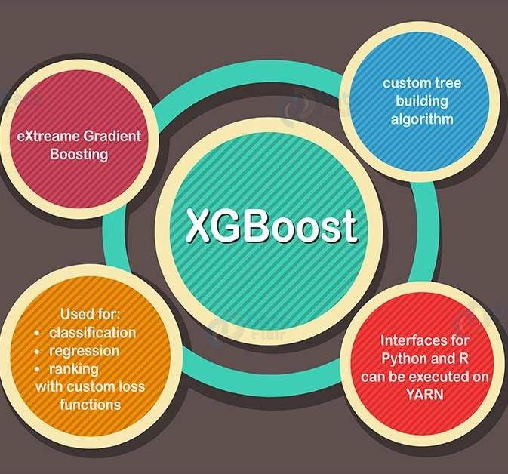
Gradient Boosting Tree
Performance and Scalability
XGBoost offers high-speed performance and efficiency, making it ideal for handling large datasets across multiple cores.
Model Enhancement Features
It supports built-in handling of missing data, regularization to avoid overfitting, and allows customization of the optimization objective.
Versatility and Wide Adoption
Widely used in the machine learning community, XGBoost can tackle both regression and classification problems across various programming languages.

Slide 3

Key metric
0.97 | 0.94 | 0.96 | 0.95
True Negative Rate | Recall | Precision | F1
0.95826
Accuracy
KPI

Slide 4
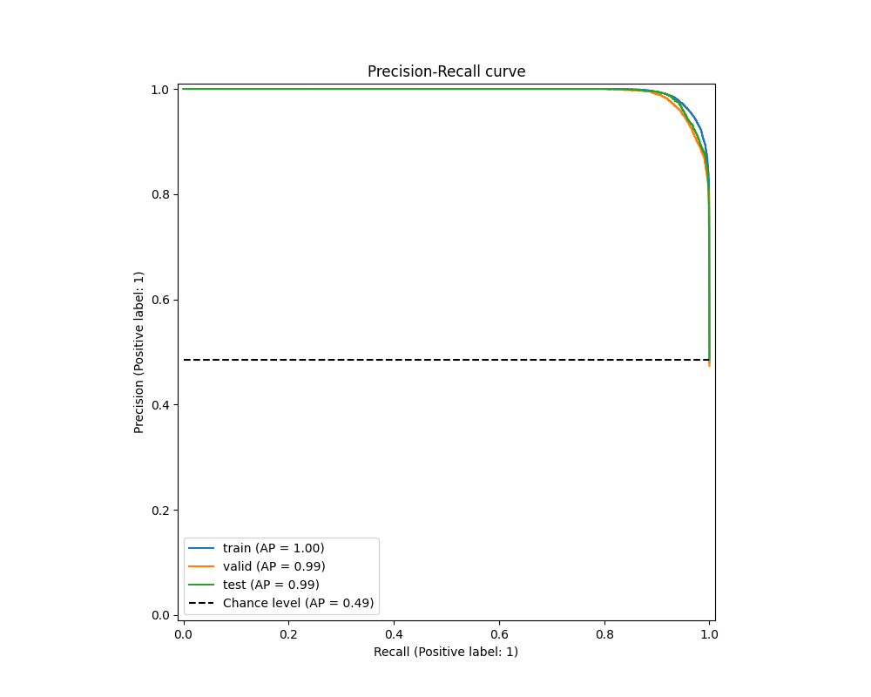
Precision vs. Recall Curve
The Precision-Recall curve visualizes the trade-off between precision (accuracy of positive predictions) and recall (coverage of actual positive cases) across different thresholds.
With ‘AP=1.00’, the model achieves a perfect Precision and Recall across all classification threshold.

Slide 5
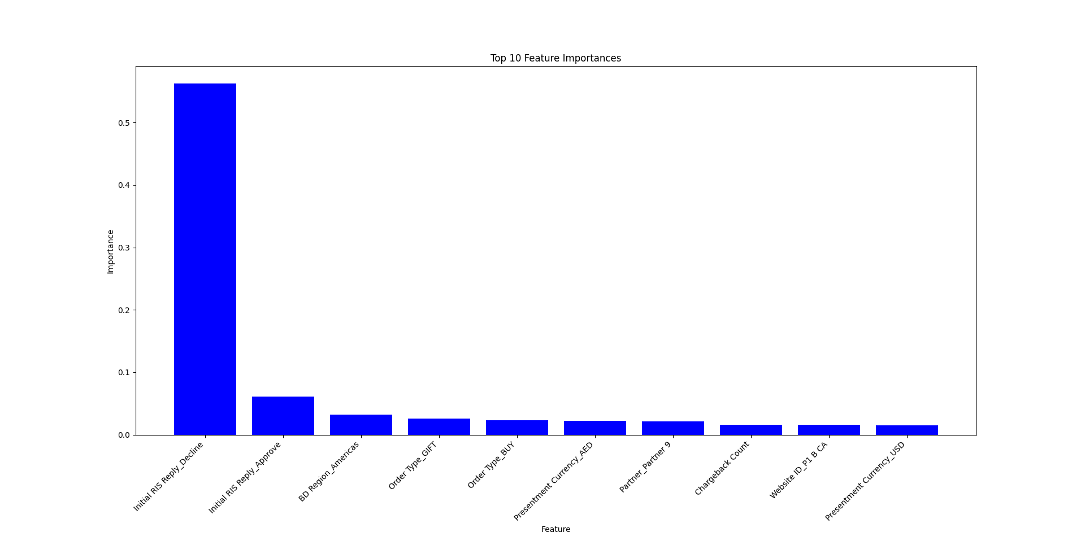
Feature importances analysis
RIS Reply Decline/Approve is the dominating feature.
As it participates in more than 80% of the final decline/approval
BD Region, Order Type are also important to look at

Slide 6
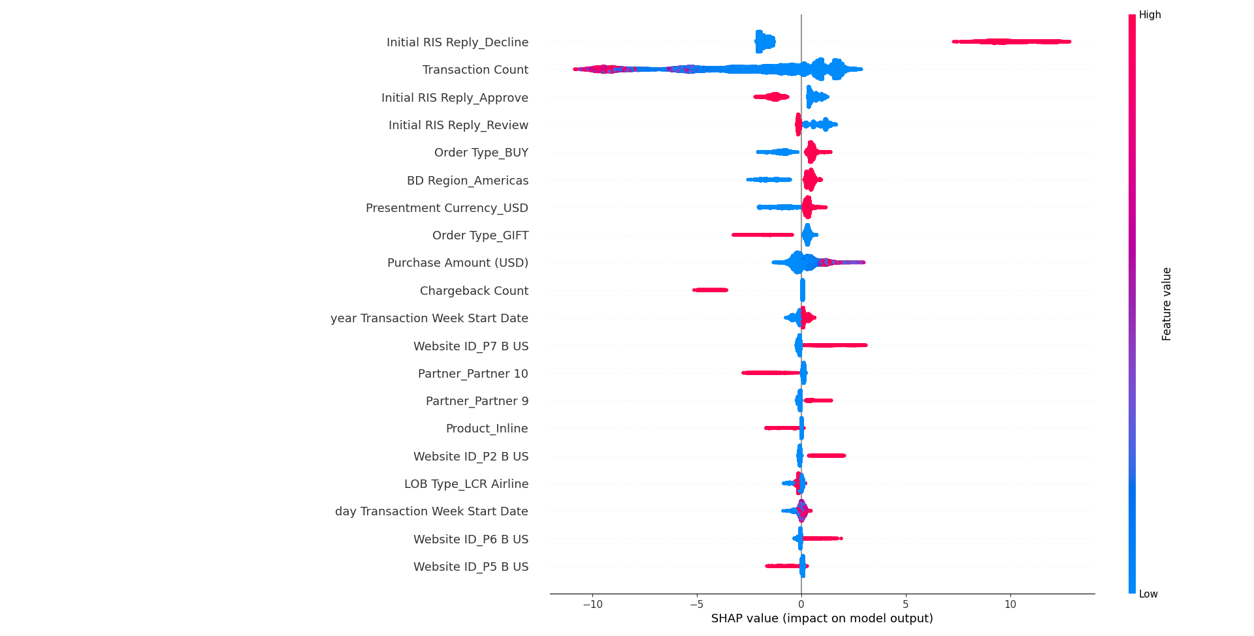
Feature importances analysis
Other Features
Transaction Count plays important role in rejection. BD Region, Order Type are also important to look at as they shows clear threshold in rejection/approval

Slide 7
Conclusion
High accuracy:
High efficiency: Light weighted, use less recourses and fast to train.
High flexibility: Can handle different data type including Tabular Data, Time series Data, Text Data and Image data. Good explainability: Can provide insight on important features.
And so on…
Wildly used in Fraud detection.

